Slide 1
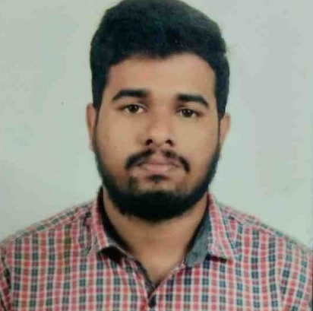

BHARAT KUMAR MEDI
Analyst/Software Engineer
Bachelor of Technlogy, Computer Science and Engineering : 2015 - 2019
Skills
C# | C#Basics,OOPS,GenericsCollections, Array,Loops,Exception Handling.
.NET | ADO.NET,ASP.NET with MVC5 and WEB API,Entity Framework
Angular | Components, Services, Modules, Routing, Forms & Validation
Database | MSSQL Server
Tools | Git, Visual Studio, postman
Add On skills | Peer learning
Bangalore
bharat-kumar.medi@capgemini.com
+91 7036639131
A4
Full Stack Developer
Full Stack developer with Angular and Full Stack .NET Developer
Hands on experience on C#,ADO.NET,LINQ,Entity framework ,Sql Server,ASP.NET MVC5 with WEB API
Practical understanding of RDBMS concepts using MsSqlServer
Knowledge on creating Single page Web Application in Angular .
Having Knowledge on Git And GitHub
Currently completing Microsoft AZ-900 certification course
OnDemand Car Wash System
Case study of OnDemand Car Wash System along with API Gateway, Swagger, responsive UI with HTML5, CSS, Bootstrap and Angular used as User Interface.
Three layered architecture which includes a Data Access Layer, Business Logic Layer using C#, ASP.NET CORE WEB API. , MSSQL Server .
Classes in all layers were designed using C# and ASP.NET CORE WEB API. Database was designed in MSSQL Server.
Connecting the application with database was done using ASP.NET CORE WEB API.
Check out my work on git hub
cc

